Slide 1
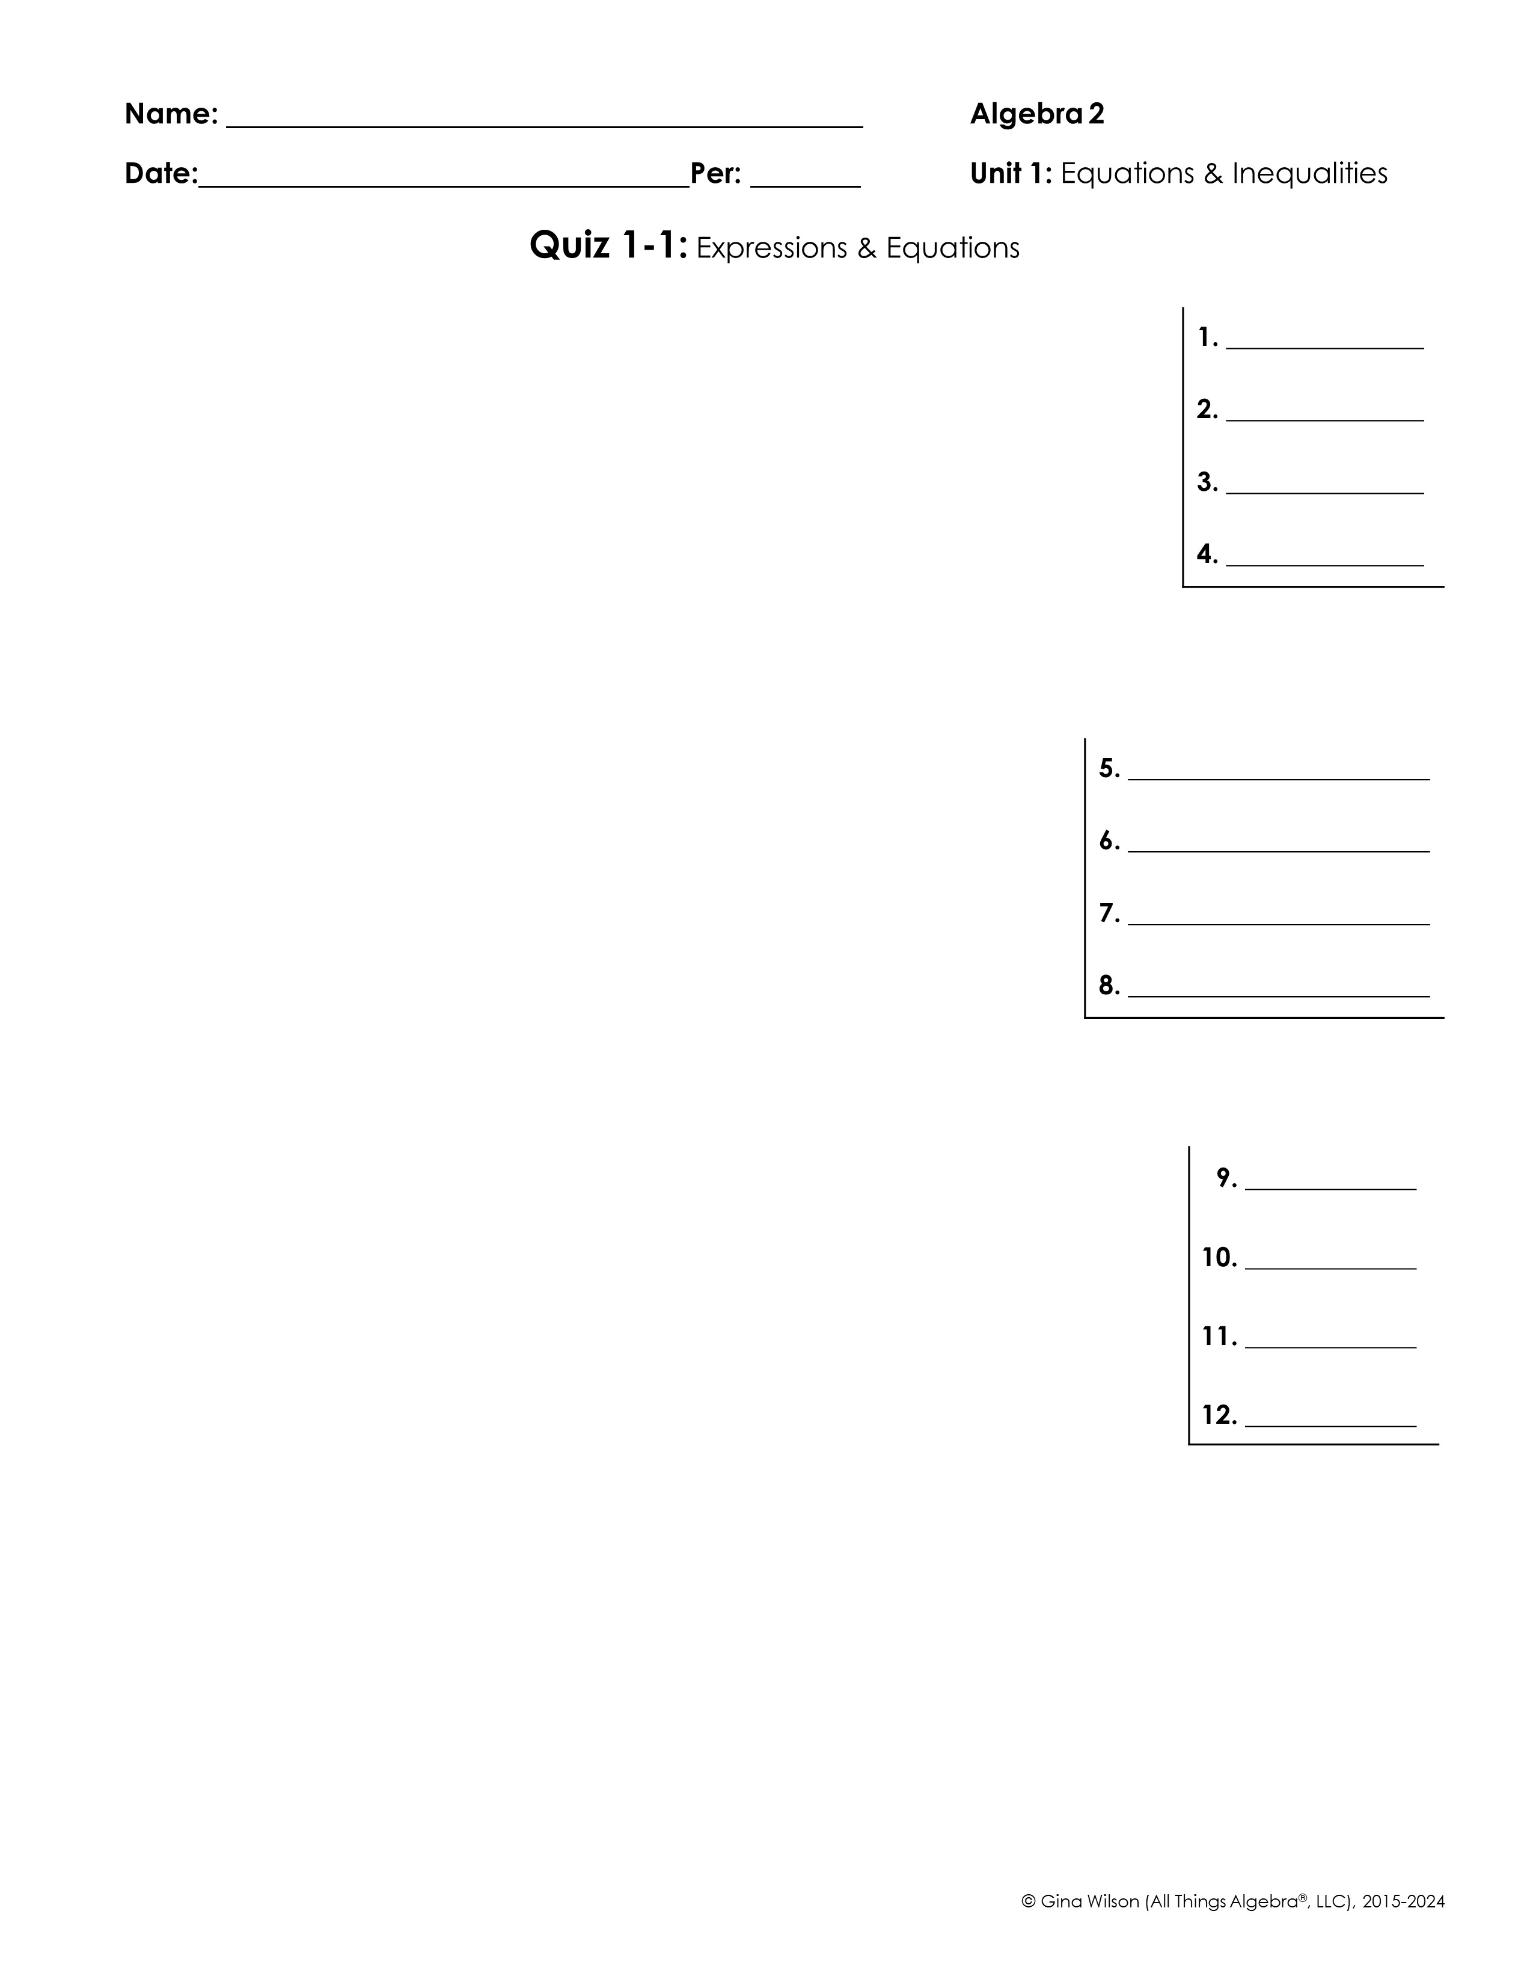
Simplify each radical expression.
1.
2.
3.
4.
Name all sets to which each value belongs. (Use R, I, Q, Z, W, N)
5.
6.
7.
8.
Simplify each expression.
9.
10.
11.
(if a = 2 and b = -6)
12.
(if x = and y = )

Slide 2

Solve each equation.
13.
14.
15.
16.
(solve for b)
Solve each equation. Be sure to check for extraneous solutions.
17.
18.
19.
20.

